Slide 1

Visual Sentiment Analysis Using Convolutional Neural Network
Dongyu She
sherry6656@163.com
Department of Computer Science
Nankai University
南开大学

Slide 2

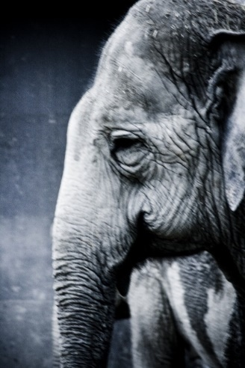
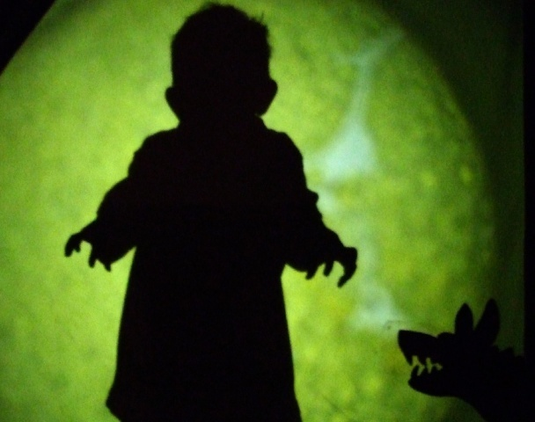
Images & Sentiments
Sentiment refers to the experience of feeling or emotion
Three constituents of sentiment:
Subject Experience: individual's self-perception towards different emotional states.
External Behavior: the physical part of reaction, e.g., expression.
Physical Arousal: the emotional response when given different stimuli.

Slide 3



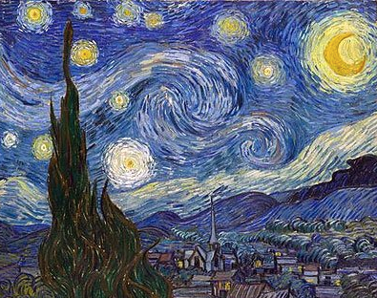
Images & Sentiments
Algorithms to identify sentiment have many applications:
blog recommendation
behaviour targeting
marketing
Appreciation of Art

Slide 4
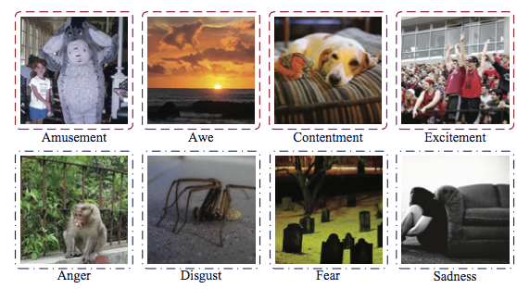
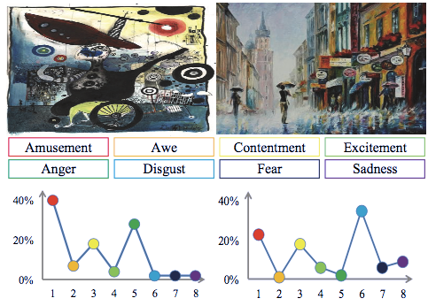
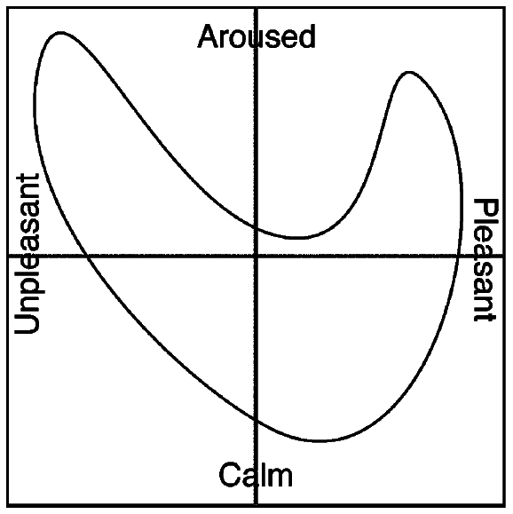
How to model sentiment?
Psychological model
Valence (the level of pleasure)
Arousal (intensity of the experience)
Dominance (the degree of control)
Arousal
Emotion categories:
Positive, Negative, Neutral
Amuse, Awe, Excitement, Contentment
Anger, Disgust, Fear, Sadness
Sentiment Distribution
Representing the degree to which each label describe the instance
Valenca
Mikels et al., Emotional category data on images from the international affective picture system (BRM’05)
JufengYang et al., Learning Visual Sentiment Distributions via Augmented Conditional Probability Neural Network (AAAI’17)

Slide 5
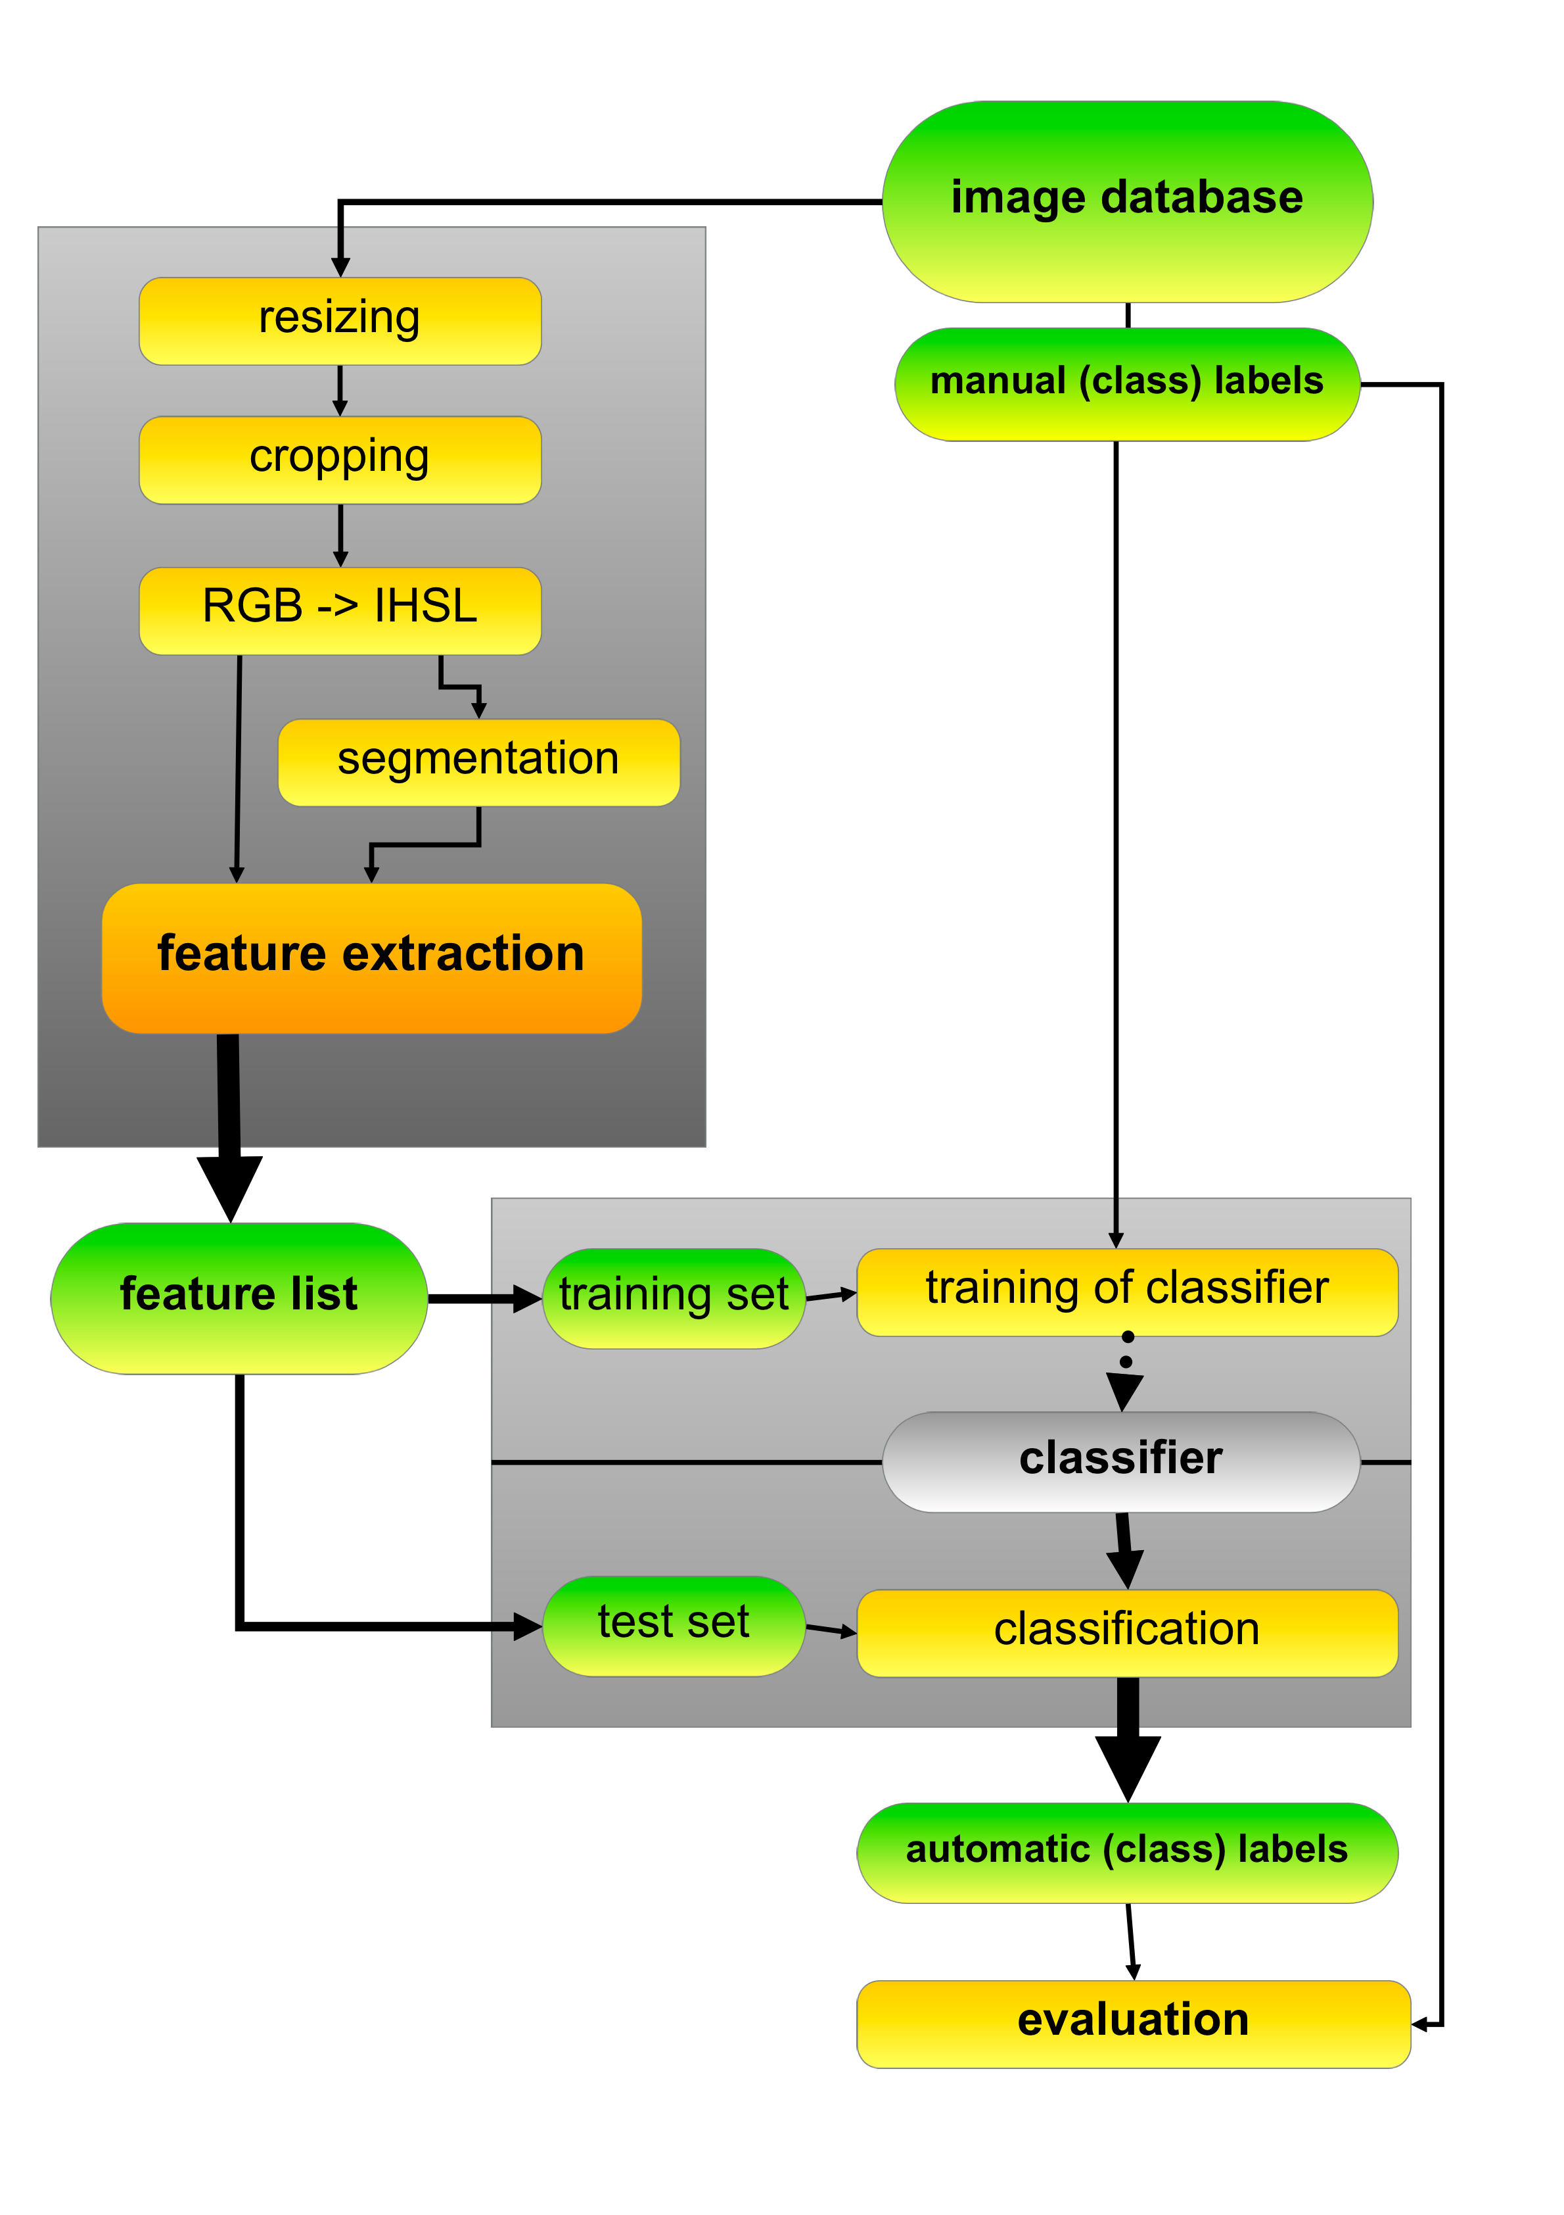
Related Work
Traditional Classification Methods
Preprocessing
Resizing, Cropping, Color space, etc.
Feature extraction
Low-level feature inspired by psychology and art theory
Mid-level feature based on the visual concept
Deep feature using Convolutional Neural Network (CNN)
Classification (2/8 categories)
SVM
Bayes
Neural Network
Machajdik et al., Affective Image Classiﬁcation using Features Inspired by Psychology and Art Theory(MM’10)

Slide 6
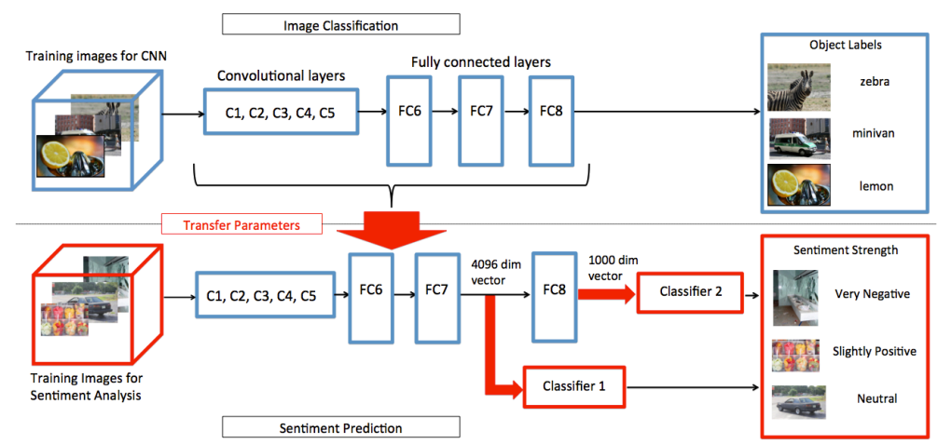
Related Work
Transfer from the pre-trained CNN
Visual sentiment prediction with deep convolutional neural networks(arXiv’14)
Diving deep into sentiment: understanding fine-tuned CNNs for visual sentiment prediction(ACM ASM’15)

Slide 7
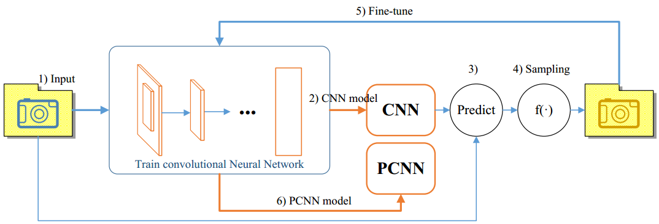
Related Work
Fine-tune with large-scale nosiy data
Robust image sentiment analysis using progressively trained and domain transferred deep networks(AAAI’15)

Slide 8
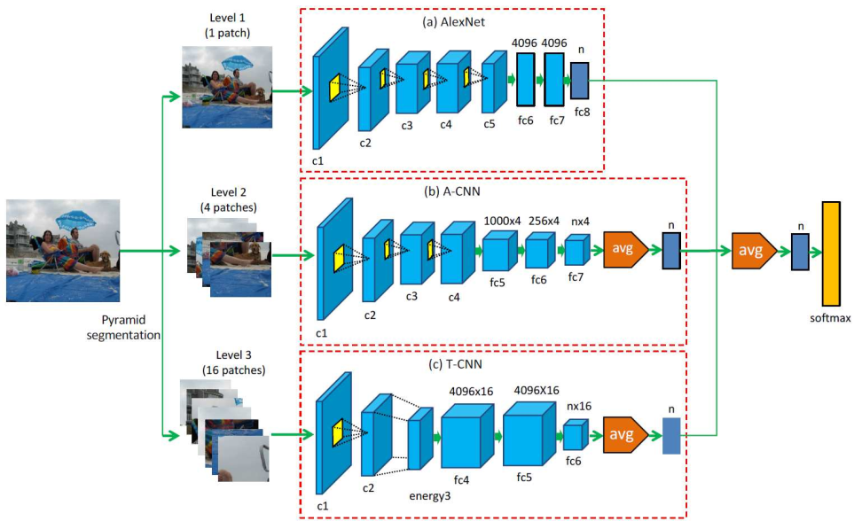
Related Work
Extracting deep features
Learning multi-level deep representations for image emotion classification(arXiv’16)

Slide 9
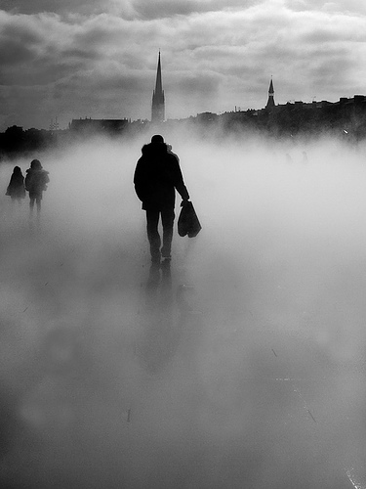
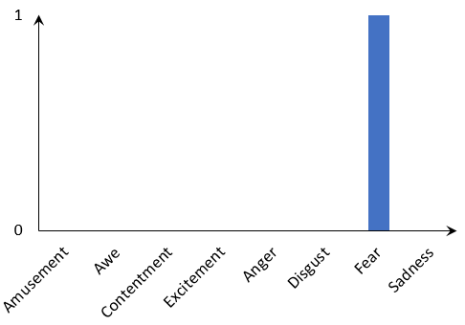
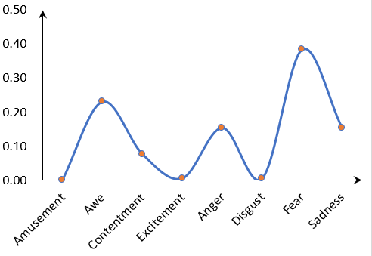
Motivation
Most existing CNN methods for emotion classification assume a single label for representing one image.
However, in practical applications:
Images convey a mixture of emotions.
People have different social and cultural backgrounds.
Differen from the object classification, analyzing images at affective level is inherently challenging due to the ambiguous information.
Label distribution learning (TKDE’16)

Slide 10
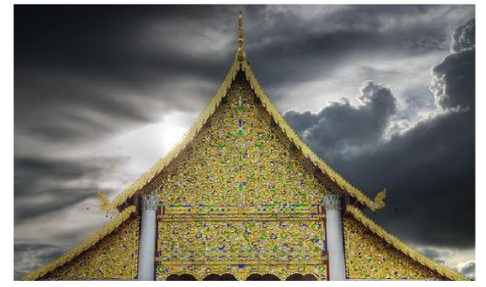
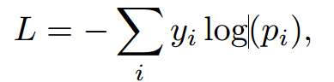
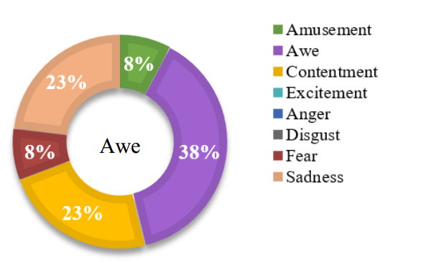
Motivation
Classic CNN model for emotion classification uses the cross entropy as the loss function, which only maximizes the log-likelihood of the dominate label while ignoring other classes:
The previous work on emotion distribution only utilize the correlation of emotion labels in classifier learning, but not in learning the visual representations through deep learning.
Jufeng Yang, Dongyu She, Ming Sun, Joint Image Emotion Classification and Distribution Learning via Deep Convolutional Neural Network (IJCAI’17)

Slide 11
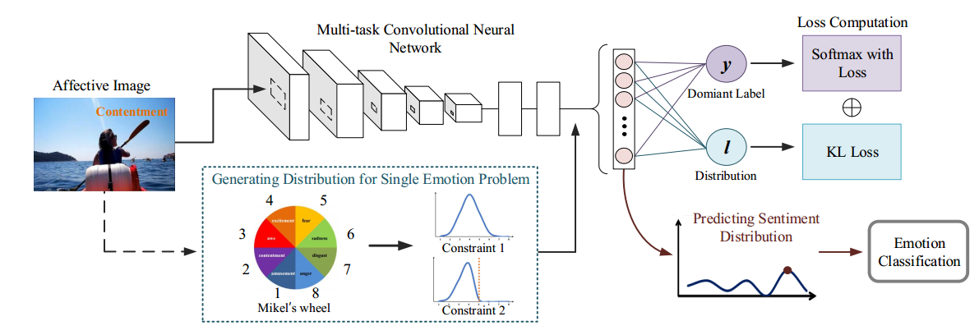
Proposed Method
We develop a deep multi-task framework to joint optimize image emotion classification and distribution learning, which takes the sentiment ambiguity into consideration.
Pipeline of our proposed method.

Slide 12
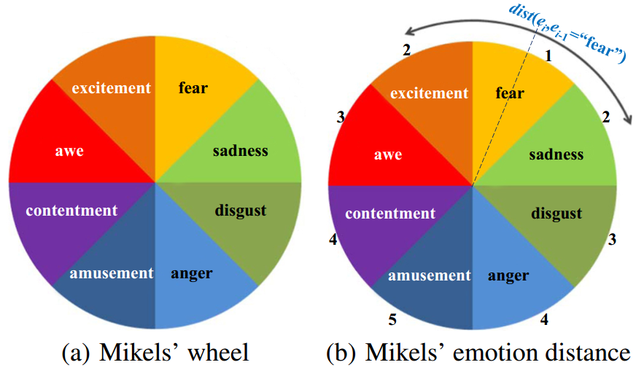
Proposed Method
For the distribution datasets, we explicitly use the votes as the ground truth label distribution.
For the single label datasets:
Some research in psychology show that there are different similarities between the pairwise emotion categories.
According to Mikel’s wheel, we fix the order of sentiment labels, and the distance can be defined by the steps between two sentiments.
The nature of emotions (AS’01)
Notes:
For the distribution datasets, we explicitly use the votes as the ground truth label distribution. We propose to generate distribution from the single label.

Slide 13
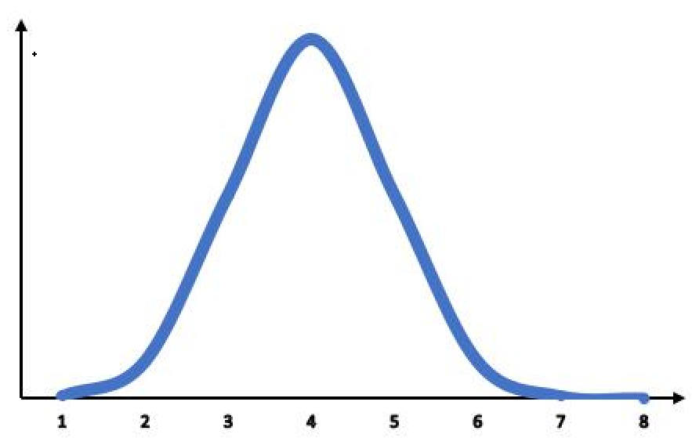
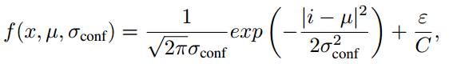
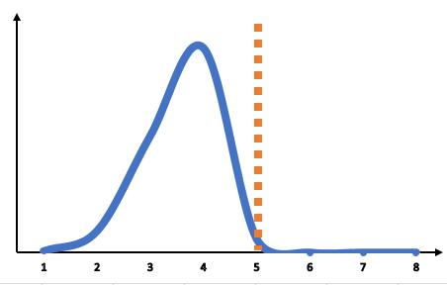
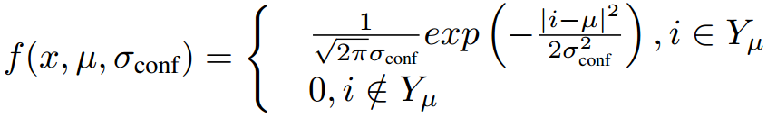
Proposed Method
Converting single emotion problem
We propose two individual strategies to generate the distribution from the single emotion dataset.
There are two common forms logical relationships, i.e. implication${(𝒴}_{i}\overset{⇒}{}𝒴_{j})$and exclusion ${(¬𝒴}_{i}∨{¬𝒴}_{j})$.
Constraint1: Implication
Constraint2: Exclusion
The distributions are then nomarlized to sum to 1.

Slide 14
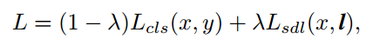
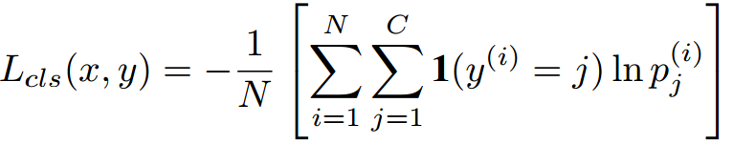
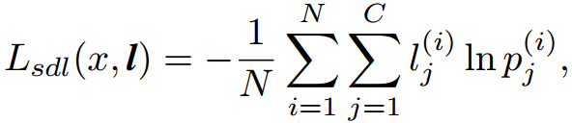
Proposed Method
Visual Sentiment Multi-task Learning
Our loss function is integrated with two types of losses through a weighted combination:
The classification task employs softmax loss:
We employ KL loss for distribution learning:

Slide 15
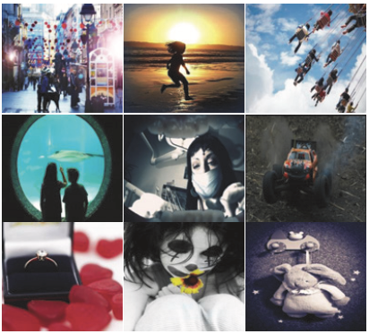
Experiment
Datasets
Evaluation
Distribution Learning Task
Chebyshev distance, Clark distance, Canberra metric, Kullback-Leibler divergence, cosine coefficient, intersection similarity
Classification Task
Accuracy
Ground Truth | Dataset | ImageNum | Class
Sentiment Distribution | Emotion6 | 1,980 | 6
 | Flickr_LDL | 11,150 | 8
 | Twitter_LDL | 10,045 | 8
Single Label | Flickr&Instagram | 23,308 | 8

Slide 16
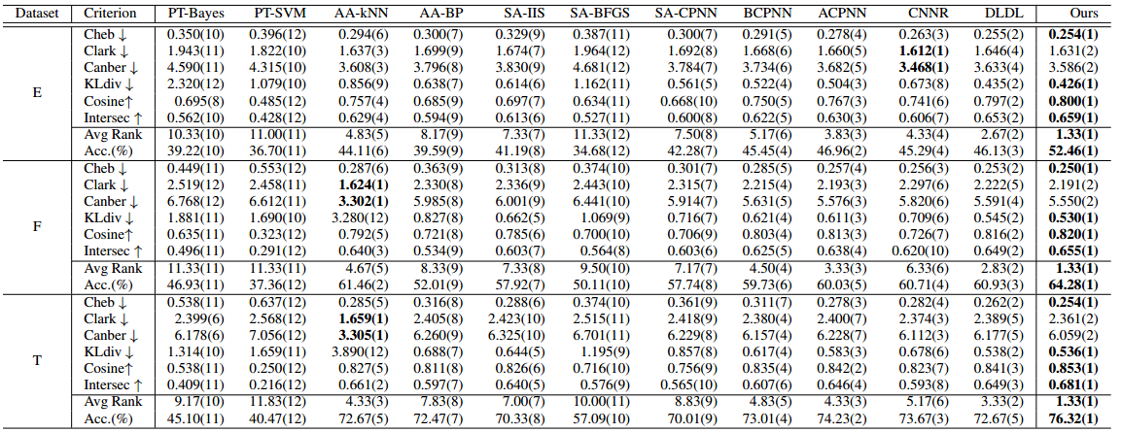
Experiment Result
Experiment on the distribution datasets:

Slide 17
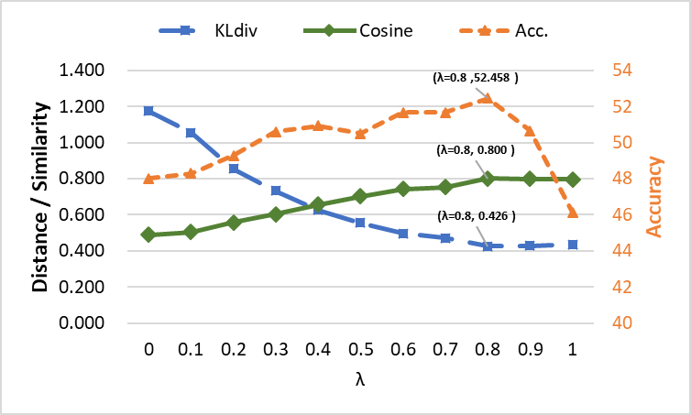
Part III
Experiment Result

Slide 18
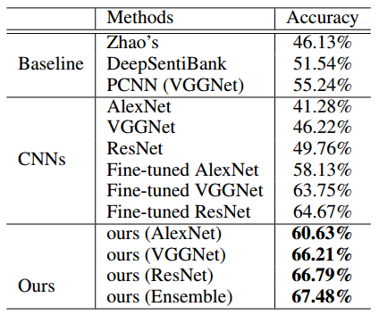
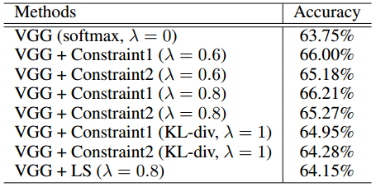
Experiment Result
Experiment on the single label datasets:

Slide 19

THANKS!
Q&A

